Slide 1
Innovation and Energy
Aleksander Śniegocki
Project Manager Energy and Climate
Euro-CASE Innovation Platform meeting in Warsaw
20/09/2016

Slide 2
About WiseEuropa
Independent, Warsaw-based think tank focusing on economic and foreign policy
Research areas:
  Public Policy and Governance
  Economics and Economic Policy – including innovation policy
  Foreign Policy and International Affairs
  Digital Economy and Technology
  Energy, Climate and Environment
In 2016, WiseEuropa became a partner of Climate-KIC, Europe’s largest public-private innovation partnership focused on climate change

Slide 3
Energy innovation – WHY?

Slide 4
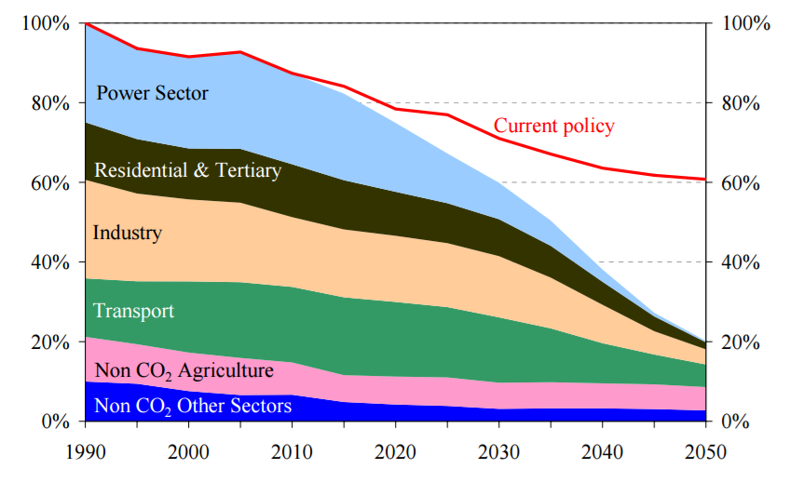
Energy innovation – WHY?
Energy challenges – climate
Greenhouse gas emissions in the EU
Source: EC (2011)
Energy use at the forefront of necessary transition

Slide 5
Energy innovation – WHY?
Energy challenges – affordability
Energy share in households’ budgets, by Member State
In Europe, cost of energy transition for households and business is manageable
Nevertheless, smooth global and European energy transition requires economically efficient solutions
Source: WiseEuropa based on Eurostat data

Slide 6
Energy innovation – WHY?
Energy challenges – security
Domestic coal & gas production as % of domestic consumption in 2014
Source: WiseEuropa based on Eurostat data
Europe becomes increasingly energy dependent
Renewables and energy effficiency seen as a long-term solution
Some Member States still interested in clean use of domestic fossil fuels

Slide 7
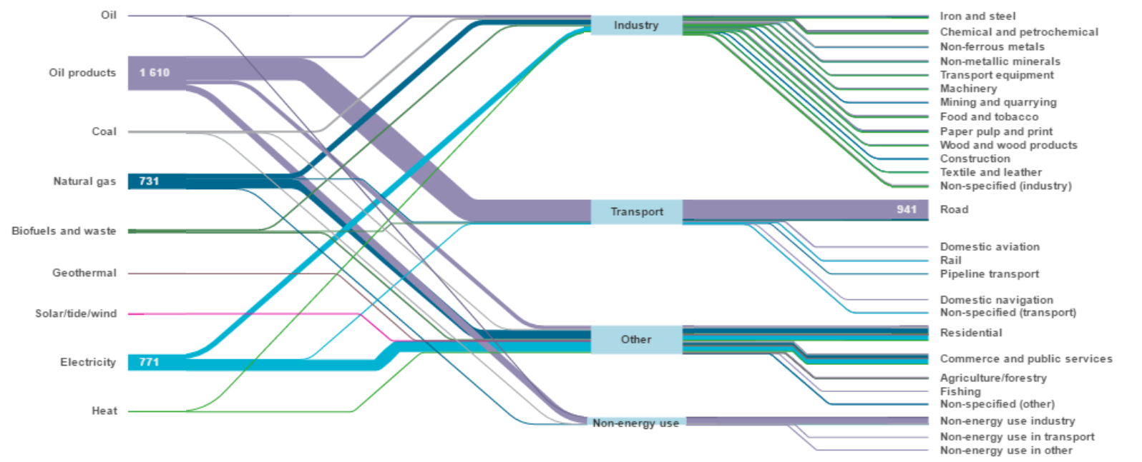
Energy innovation – WHY?
Need for systemic innovation
Sankey diagram – energy flows in IEA countries in 2013
Source: IEA
Interdependencies and synergies within broad energy system

Slide 8
Energy innovation – WHY?
Need for breakthrough innovation
Avoiding path dependency
Low-emmission vs lowER emission solutions
Key role of long-term investment

Slide 9
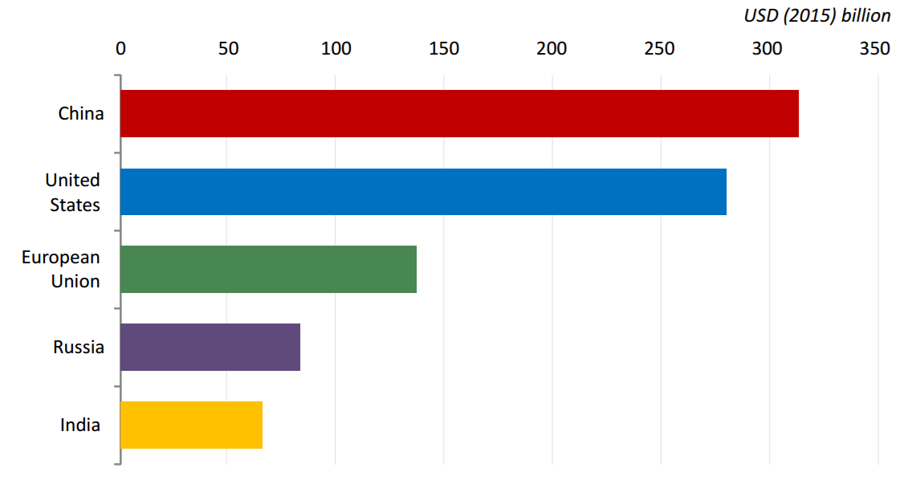
Energy innovation – WHY?
Need for scalable innovation
Energy supply investment in 2015
Source: IEA
Urgency of climate crisis
Business opportunities – new markets beyond Europe

Slide 10
Energy innovation – WHY?
European challenges and opportunities
Energy transition pioneer
Research potential
Climate policy ambition
USA and China catching up
European paradox
Climate policy implementation

Slide 11
Energy innovation – WHY?
Bottom line:
Europe urgently needs
systemic, breakthrough, scalable innovations
delivering clean, affordable and secure energy

Slide 12
Energy innovation – HOW?

Slide 13
Energy innovation – HOW?
Strengthening general innovation potential
Innovation vs eco-innovation performance
Source: WiseEuropa based on EC data
Sectoral innovation builds upon general innovation potential

Slide 14
Energy innovation – HOW?
Robust policy framework – energy market reform
Technology neutral
(incl. demand side)
Providing
security of supply
Single market: infrastructure and regulation

Slide 15
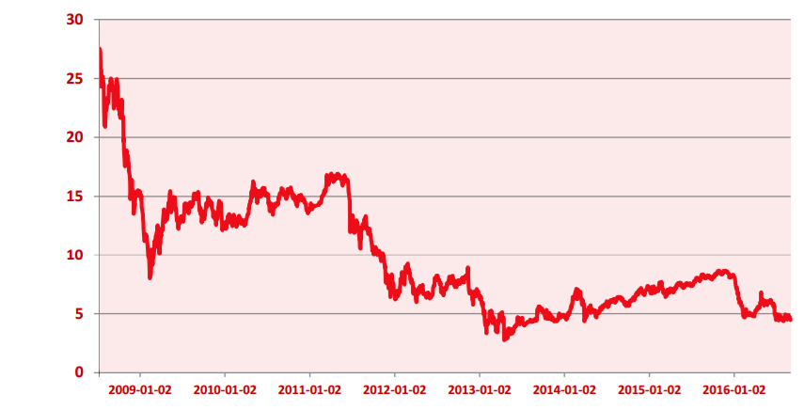
Energy innovation – HOW?
Robust policy framework – climate targets
EU ETS allowance prices, EUR/tCO2
Source: KOBiZE
Importance of long-term carbon price signal
Ongoing debate on ETS and non-ETS policy framework

Slide 16
Energy innovation – HOW?
Robust policy framework – setting R&D priorities
Support focus
Thematic
Technology
Horizontal
Ongoing debate on horizontal vs sectoral industrial/R&D policy
Energy as a Societal Challenge in Horizon 2020
American example: ARPA-E, “DARPA for energy”

Slide 17
Energy innovation – HOW?
From clean energy idea to market
R&D support
Carbon pricing (mass deployment)
Standards (eliminating inefficiencies)
Subsidies (early deployment)
Capital-intensive technologies → pilots/market entry challenging → Death Valley problem

Slide 18
Energy innovation – HOW?
Pooling resources
Single market
Regulatory burden
Policy inertia
Knowledge exchange
European value added

Slide 19
Energy innovation – HOW?
From policy frameworks to action
Energy
Climate
Innovation
Policy framework
Establishing policy framework is only a beginning.
Next steps include:
Bringing stakeholders together
Discovering promising ideas and market needs
Innovating to learn, learning to innovate

Slide 20
Climate-KIC:
delivering innovation

Slide 21
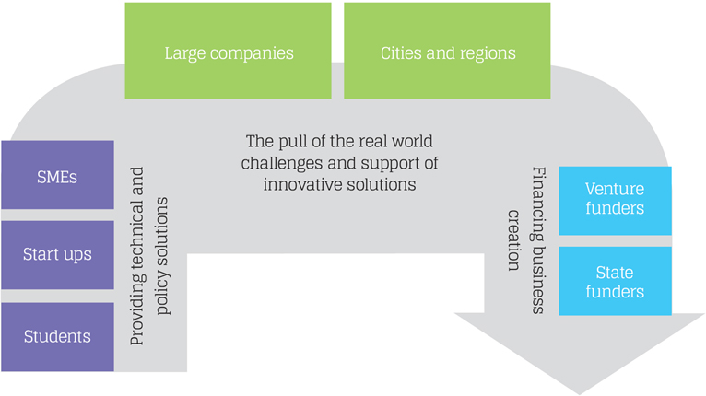
Climate-KIC: delivering innovation
About Climate-KIC
KICs (Knowledge and Innovation Communities) are thematic innovation partnerships co-financed by European Institute of Innovation and Technology (EIT)
Climate-KIC focuses on climate change mitigation and adaptation
It brings together
business,
research institutions
and local authorities
Source: Climate-KIC

Slide 22
Climate-KIC: delivering innovation
Thematic priorities of Climate-KIC
Urban Transitions
Sustainable Production Systems
Decision Metrics & Finance
Sustainable Land Use
Focus on systemic challenges rather than technologies
Energy-related innovations as a part of broader solution

Slide 23
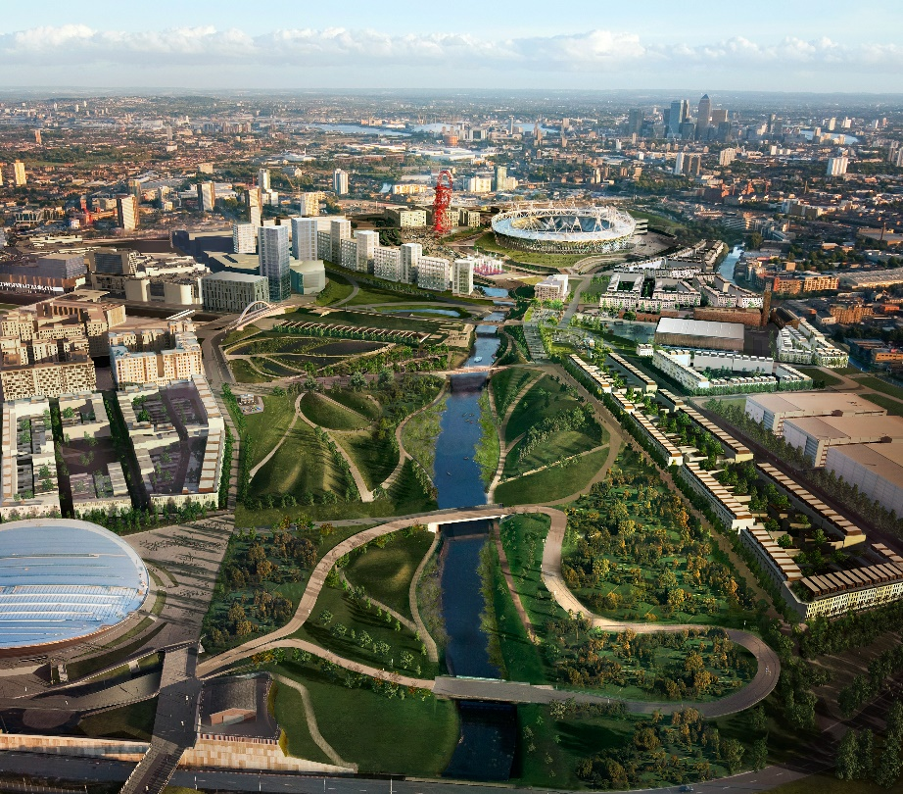
Climate-KIC: delivering innovation
Climate-KIC in action - examples
Sustainable Smart Districts:
district-scale innovations
systemic approach
scaling up and providing example for other cities
Source: Climate-KIC

Slide 24
Climate-KIC: delivering innovation
Climate-KIC in action - examples
Innovative start-ups and solutions:
Using waste heat from IT infrastructure
IT solutions for CAPEX-free energy efficiency improvements in office buildings
Decision support tools for planning city-level energy transition
Exploring CO2 reuse options in industry

Slide 25
Summary:
Towards an innovative Energy Union
Notes:
Robust climate and Energy policy + general improvements for innovation policies + unlocking single EU market potential + driving concrete action from local to European level

Slide 26
Thank you for your attention

