Slide 1
Innovation and Energy

Slide 2
This draft of report is a presentation of the initial state of the energy mix in typical countries of the region, research and development problems as well as limitations hindering the implementation of new innovative solutions in this area.

Slide 3
History
The start of a process of unification of the European continent dates back to 1989 when the Berlin Wall fell.
In 1989 there were two significantly different economic areas. The first area covered the developed countries of Western Europe, the second is the countries that drifted away from the influence of the USSR.
centrally planned economies
the energy intensive industries (such as heavy industry and arms industry) were well-developed
the ownership structures bringing together large groups of people (e.g. housing cooperatives inhabited by tens of thousands of people) affected the development of systems supplying heat and electricity to towns
coal and nuclear fuel were the most widely used fuels in power generation; other energy sources were practically non-existent.

Slide 4
free market economies
energy intensive industries were of less relevance in West European countries; in these countries, greater attention was given to reducing energy generation costs
the arms industry did not play a large role in the economies of those countries
the most households were equipped with individual systems assuring proper temperature and thermal comfort; the centralised systems were less frequent and small in size compared to those existing on the other side of the wall
natural gas was already used for heating purposes, due to a wide dispersion of energy consumers
the power engineering based on renewable energy sources was gradually developing in this part of Europe and the promotion of energy saving always came first no matter the situation.

Slide 5
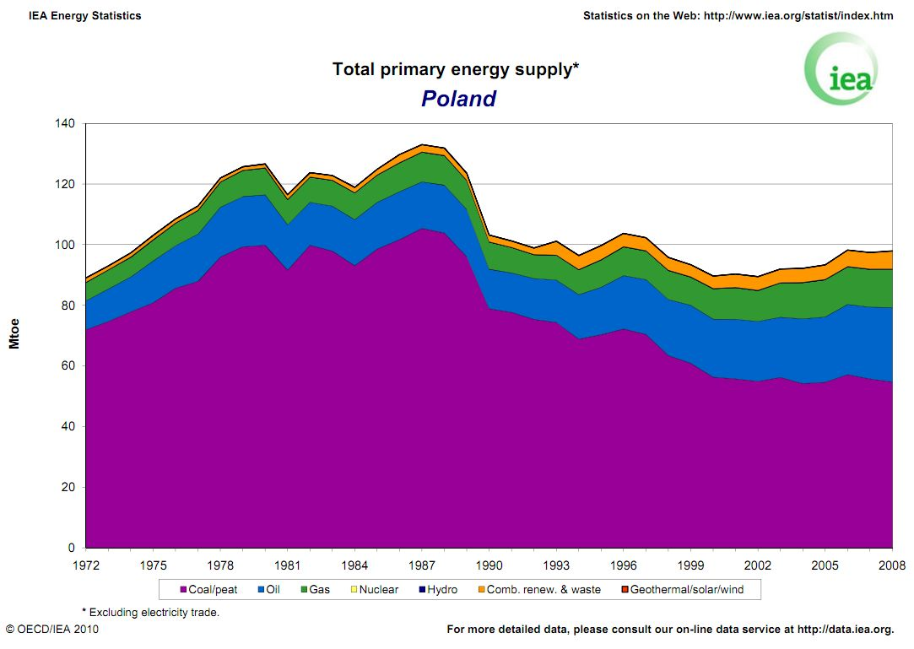
Use of various fuels for the purposes of energy production in Poland
In 1989, there is a clear decline in energy consumption in Poland, related to the economic crisis and sharp decrease in the role of heavy and arms industries. Moreover, since the beginning of the 1990s, the country has developed in the direction of widely understood renewable resources and the reduction of the share of coal in the electricity production.

Slide 6
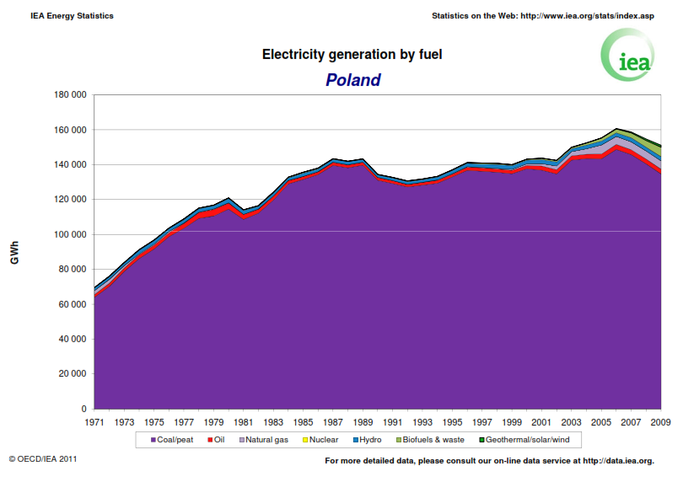
Consumption of various fuels for the purposes of electricity generation in Poland
Poland's dependence on coal is evident in the diagram showing the consumption of various fuels for the purposes of electricity generation - more than 80 % of electricity is produced from coal.

Slide 7
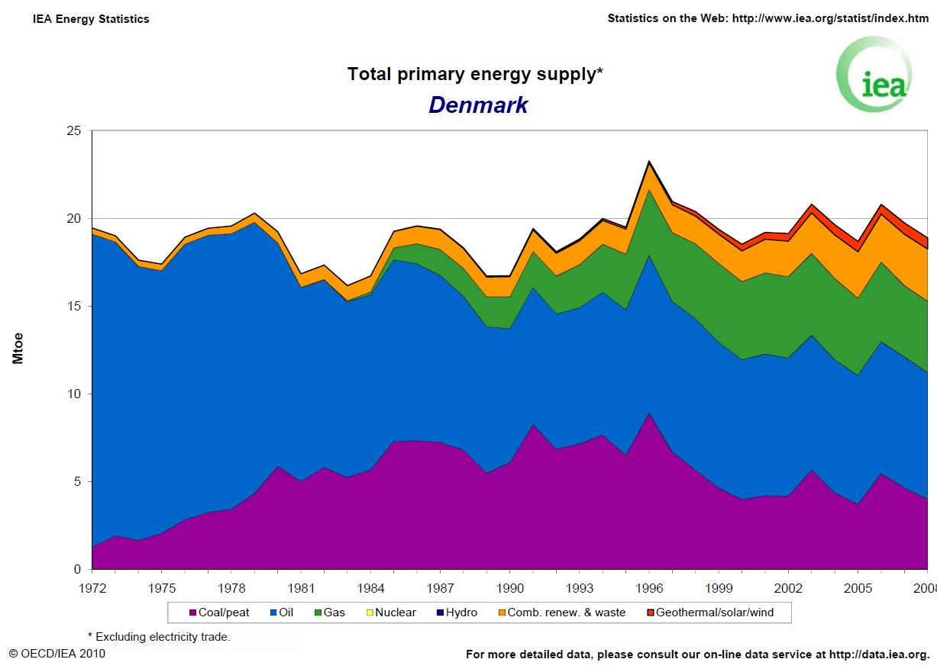
Consumption of various fuels for the purposes of energy production in Denmark
The energy management in Denmark was based on crude oil until the oil crisis of 1973, and thereafter only the considerable increase in oil prices (the economic factor) began the search for alternative energy sources.
Denmark had no coal deposits. It was likely that the different fuels in Danish energy mix were deliberately spread as evenly as possible, and using practically all available energy sources.

Slide 8
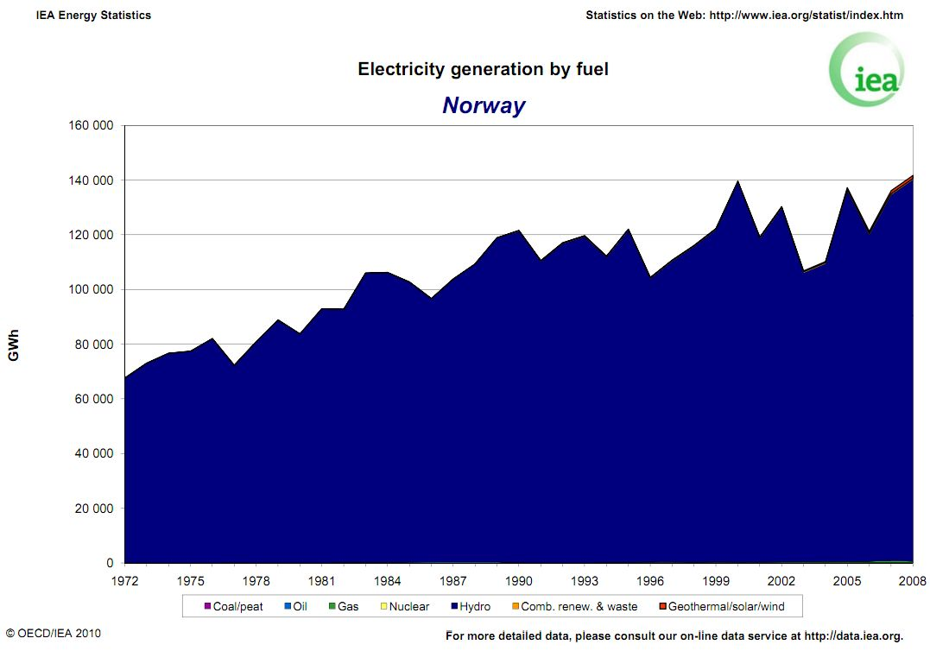
Geographical location and available energy resources
Consumption of different fuels for the purposes of electricity generation in Norway
The country has favourable geographical location, there is a fairy high number of rivers providing the basis for building small hydropower plants. This made it possible to meet the Norwegian electricity needs with hydropower.

Slide 9
An example of this is Poland with over one hundred years of tradition of coal mining. The availability of this fuel and also the well developed extraction and transferring infrastructure have provided a continuous and uninterrupted supply of energy for many decades.
The Mediterranean countries are an example that points the way to exploiting the particular characteristics of regions – the intense growth of wind energy sector.
Summary
The historical circumstances presented above provide the basis for any discussion on changes and innovations in energy systems of European countries.
It seems that, in view of the circumstances outlined above, no single power engineering mod-el defining the innovation strategy can provide a guarantee of ultimate success in all EU countries.
Defining the ultimate objectives without choosing the manner in which they are to be met, seems to be the most promising way forward.

Slide 10
Technological innovations in power engineering
- innovations related to large-scale energy production,
a) lowering of costs of energy generation,
b) lowering of CO₂ emissions, while at the same time protecting the environment
e.g. the construction of the supercritical blocks of a coal fired power plant (a 844 MW block already built and five more are still under construction – all in Poland) that can produce electricity with the efficiency exceeding 40%, which reduces the production costs and decreases CO₂ emissions to atmosphere.
- innovations related to small-scale energy production,
a) lowering of costs of energy generation,
b) lowering of CO₂ emissions, while at the same time protecting the environment
In this area, there are both large enterprises (taking into account the economies of scale) and small enterprises, for which the possibility of implementation of the developed solution is the key issue.
Diversification of energy production (including electricity production) has a positive effect on security of the energy sector.

Slide 11
Technological innovations in power engineering
- innovations related to transmission and storage of energy
a) storage of heat and cold
b) electricity storage
c) transmission of electricity, thermal energy transfer
During the operation of each energy system, there are periods of energy shortage or surplus. The possibility to store the surplus energy (heat, cold or electricity) would optimize the performance of such systems, reducing energy losses and improving efficiency.
One of the factor limiting the ability to innovate in this area is the structure of the energy market, which is dominated by relatively large enterprises engaged in energy supply. Any changes or modifications in the system are associated with decisions taken often at the highest corporate level, which obviously affects the speed of its making and the difficulty in obtaining the required permissions.
innovations allowing optimum management of the energy mix.
Link between distributed energy sources in a given area with the systems of energy consumption is leading to optimal operation of such a comprehensive system.

Slide 12
The problems encountered when implementing innovative solutions can be divided into several groups according to the nature of the research process that ends with the implementation of products and services.
A stage of research – there are a lot of regional, national and UE thematic programmes providing assistance in particular areas. It seems that the existing support for SMEs (small and medium enterprises) and large enterprises is sufficient.
A stage of pilot installations. This stage is particularly important, practically for every new installation which is a part of the energy sector. Research on the functioning of the new installation itself and its incorporation into the energy system is carried out. In this stage, there are also assistance programmes but they are only targeted at large and very large enterprises which can afford large-scale pilot programmes. There are no assistance programmes dedicated for relatively small enterprises or relatively small installations.
A stage of implementation of devices to serial production. The existing assistance programmes related to this stage are not well thought out. In the opinion of the authors of this article, they cannot support the placing of a product on the market in the case of SMEs. This situation covers all product groups and is particularly negative for products manufactured by relatively small enterprises. In several EU countries and also in the United States of America, this gap is filled by private investors that are more likely to risk taking. However, in Poland there are virtually no such investors.

Slide 13
Projects at the national level (Poland)
In Poland, there are two government agencies involved in research and knowledge transfer:
National Science Centre (funding the works of a fundamental nature)
National Centre for Research and Development (supporting the works predominantly meant to implement in industrial practice)
A separate group supporting cooperation between science and entrepreneurs, are the programs run by smaller government agencies related to environmental protection (i.e. Voivodship Inspectorates for Environmental Protection, National Fund for Environmental Protection and Water Management), as well as government agencies supporting the industry (e.g. Industrial Development Agency).
Advanced Technologies for Energy Generation (NCRD, NCBR)
was launched to develop technological solutions the implementation of which would reduce a negative impact of the energy production sector on the natural environment

Slide 14
Research tasks:
1. Developing a technology for high efficient zero emission coal blocks integrated with CO2 capture from exhaust gases (consortium leader – Silesian Technical University);
2. Developing a technology of oxyfuel combustion for pulverized fuel and fluidized-bed furnaces integrated with CO2 capture system (consortium leader – Częstochowa University of Technology)
3. Developing a technology of coal gasification for high efficient production of fuels and electric power (consortium leader – Stanisław Staszic Academy of Mining and Metallurgy);
4. Developing integrated technologies of fuel and energy production from biomass, agricultural wastes and other resources (consortium leader – Robert Szewalski Institute of Fluid-Flow Machinery, Polish Academy of Sciences).

Slide 15
THANK YOU

